Slide 1
CSCE 430 Project $$Cache Money$$
Brett Baumert
Curtis Johnson
Jake Reisdorff`

Slide 2
Overview - Our design process
Came up with overall design (instructions, etc)
Developed Assembler
Constructed datapath
Construction of individual stages
Connection of each stage
Implementation of other components

Slide 3
Overall Design
Based on MIPS 5 stage pipeline design
32 bit instruction length
Nine total instructions
Add, Add Immediate, Multiply, Load Word, Store Word, Branch on Equal, Branch on Not Equal, Jump, and No Operation (nop)
Subset of MIPS tailored for our usage

Slide 4
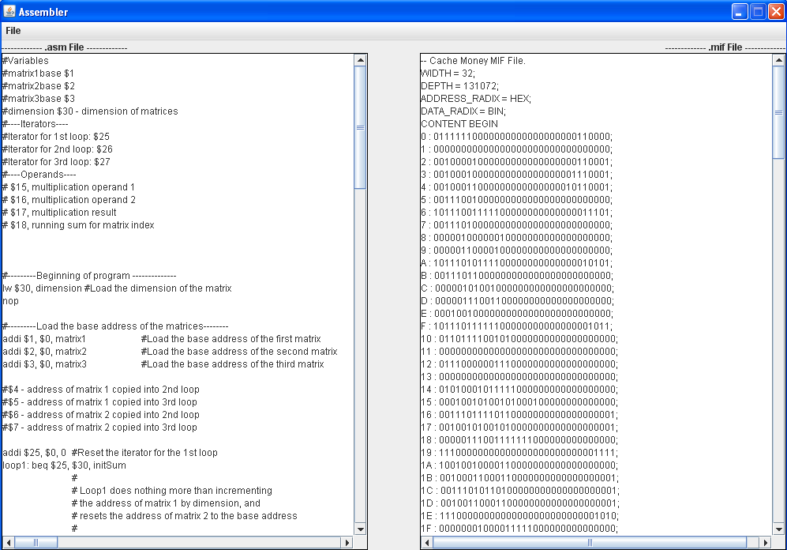
Assembler
Written in Java!
Is not responsible for optimaztion

Slide 5
Assembler
Assembler carries much abstraction
Each Instruction implements one or several interfaces, depending upon its usage (Arithmetic, Immediate, etc)
Adaptability
To add a new instruction, determine its type, and implement the required interfaces (Very easy)
Adapt datapath for the new instruction

Slide 6
Datapath Design
Accounted for multiple types of hazards
Developed each stage individually
Integrated required stages / components
Testing / Future Work

Slide 7
Branch Prediction
Implemented as always ‘not taken’
Branching Logic contained within the control unit in the ID (Instruction Decode) stage
Penalty? One cycle!

Slide 8
Handling Hazards
Hazard Detection Unit
All hazards resolved in hardware
Control Unit
Handles flushing of stages
Handles stalling of pipeline

Slide 9
Branch Hazards
add $2, $3, $0
beq $2, $5, somewhere
Introduces a RAW (Read after Write) hazard
Did not want to extend forwarding logic to ID stage
Solution: Insert bubbles!

Slide 10
Load Word Stall
lw $31, $13
add $2, $31, $31
Can’t depend on forwarding values from memory
High latency
Solution: Insert bubble!

Slide 11
Other Data Hazards
add $2, $3, $1
add $4, $2, $2 Data Dependencies
Ensure each instruction has the most up-to-date value
Solution: Fowarding Unit for multiple stages

Slide 12
Forwarding Unit
Interconnects multiple stages, including Execution Stage, Memory Stage, and Register Write Back Stage
Forwards most up to date values to the Execution Stage where they are needed
Handles prioritization (Value from Memory Stage should take precedence over Write Back Stage)

Slide 13
Memory Implementation
Use of Quartus megafunction RAM blocks
Why?
Directly loaded file from assembler output
Existed in both Instruction Fetch Stage and Memory Stage
Essentially, these act as caches for our pipeline

Slide 14
Other Useful Tidbits
Processor clock: 50 MHz
Both Memory Blocks (Data caches) hold 1 KB of data
The 10x10 matrix case used ~97% of memory block
Entire implementation : ~9% of FPGA
Performed matrix multiplication!
17 Warnings! (No inferred latches…)

Slide 15
Significance of Pipeline
Overall Faster Processor
Ability to greatly increase the clock speed!
Hardware Abstraction
Like software abstraction, creates modules that work together, but are mostly independent of one another.

Slide 16
Problems Encountered
Accounting for many hazards throughout the pipeline
Debug time
Compile time…
Inferred Latches (VHDL)
SRAM/Cache Integration
Interfacing with the SRAM
Using multiple cycles to read from memory into cache / write through to cache / satisfy requests from both IF and Memory stages
Needed a cache & memory controller…

Slide 17
Money Machine
Money Machine – a completely on-chip cache and memory controller, usable throughout the entire pipeline.

Slide 18
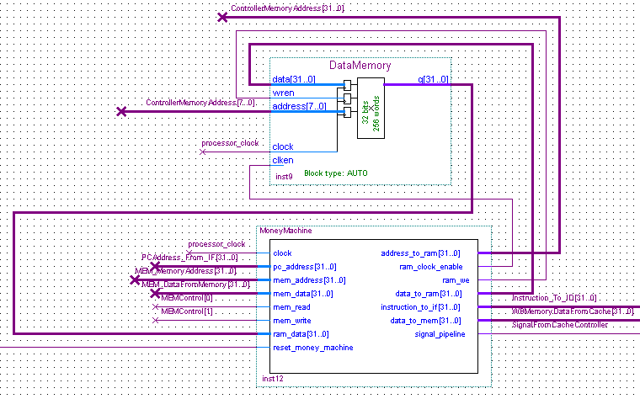
Money Machine

Slide 19
Teamwork
Much collaboration took place in designing everything from instruction set to working processor
Each member was involved in every aspect of the project

Slide 20

end: jmp end

